Slide 1
ASP .NET MVC
By - Bhushan Pawar 19 March, 2018

Slide 2
Contents
ASP.NET MVC - Overview
Why ASP .NET MVC?
Benefits of ASP .NET MVC
ASP .NET MVC Pattern
What is MVC?
ASP .NET MVC – Getting Started

Slide 3
Contents
ASP.NET MVC – Life Cycle
ASP .NET MVC - Routing
ASP .NET MVC - Controllers
ASP .NET MVC - Actions
ASP .NET MVC – Types of Actions
ASP .NET MVC - Filters

Slide 4
Contents
ASP.NET MVC – Selectors
ASP .NET MVC - Views
ASP .NET MVC – Data Model
ASP .NET MVC - Databases
ASP .NET MVC – Validations
ASP .NET MVC - Razor

Slide 5
ASP.NET MVC Overview
ASP.NET MVC is basically a web development framework from Microsoft
The Model-View-Controller (MVC) architectural pattern separates an application into three main components: the model, the view, and the controller.
The ASP.NET MVC framework provides an alternative to the ASP.NET Web Forms pattern for creating Web applications.
The ASP.NET MVC framework is a lightweight, highly testable presentation framework that (as with Web Forms-based applications) is integrated with existing ASP.NET features, such as master pages and membership-based authentication.
The MVC framework is defined in the System.Web.Mvc assembly.

Slide 6
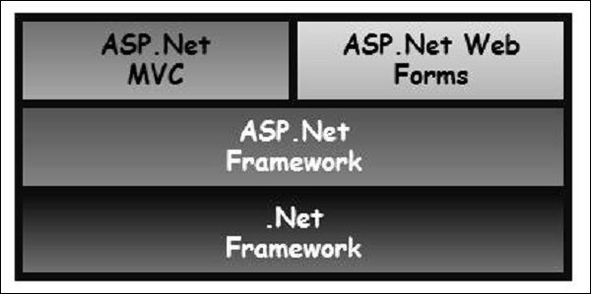
Why ASP.NET MVC?
ASP.NET MVC is basically a web development framework from Microsoft, which combines the features of MVC (Model-View-Controller) architecture, the most up-to-date ideas and techniques from Agile development, and the best parts of the existing ASP.NET platform
It is built on the top of ASP.NET, so developers enjoy almost all the ASP.NET features while building the MVC application.

Slide 7
Benefits of ASP.NET MVC
Makes it easier to manage complexity by dividing an application into the model, the view, and the controller.
Enables full control over the rendered HTML and provides a clean separation of concerns.
Direct control over HTML also means better accessibility for implementing compliance with evolving Web standards.
Facilitates adding more interactivity and responsiveness to existing apps.
Provides better support for test-driven development (TDD).
Works well for Web applications that are supported by large teams of developers and for Web designers who need a high degree of control over the application behavior

Slide 8
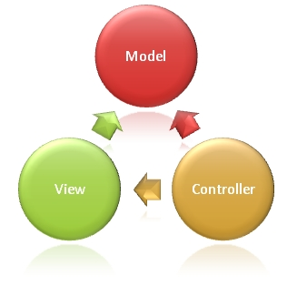
ASP.NET MVC - Pattern
Model
Business logic and validation of the application’s data domain
The real world object and provides data to the view
View
components that display the application’s user interface
Controller
components that handle user interaction
work with the model
Select the right view to render

Slide 9
What is MVC?
Request
Controller
Step 1
Incoming request directed to Controller

Slide 10

What is MVC? (Contd.)
Controller
Model
Step 2
Controller processes request and forms a data Model

Slide 11

What is MVC? (Contd.)
Controller
View
Step 3
Model is passed to View

Slide 12

What is MVC? (Contd.)
Controller
View
Step 4
View transforms Model into appropriate output format

Slide 13
What is MVC? (Contd.)
Controller
View
Response
Step 5
Response is rendered

Slide 14
ASP.NET MVC - Getting Started
Create ASP. Net MVC Application
Add Controller
Demo

Slide 15
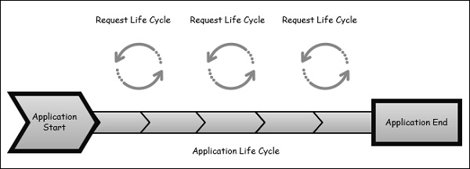
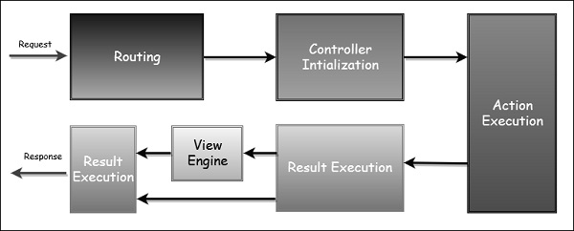
ASP.NET MVC - Life Cycle
The Application Life Cycle
The Request Life Cycle

Slide 16
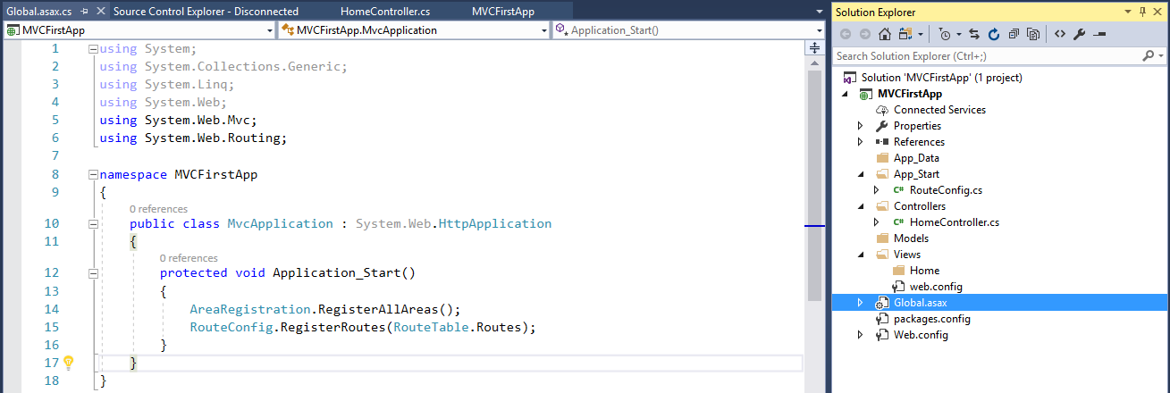
ASP.NET MVC - Routing
Routing is the process of directing an HTTP request to a controller and the functionality of this processing is implemented in System.Web.Routing.
This assembly is not part of ASP.NET MVC. It is actually part of the ASP.NET runtime, and it was officially released with the ASP.NET as a .NET 3.5
The MVC framework leverages routing to direct a request to a controller.
The Global.asax file is that part of your application, where you will define the route for your application.

Slide 17
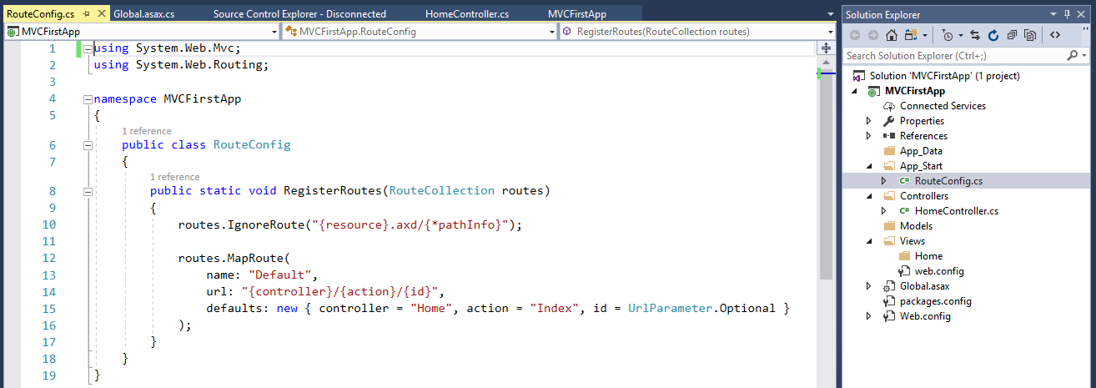
ASP.NET MVC – Routing (Contd.)
Following is the implementation of RouteConfig class, which contains one method RegisterRoutes.
Define the routes that routes will map URLs to a specific controller action.
An action is just a method on the controller
This route that is defined in the application is the default route

Slide 18
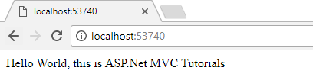


ASP.NET MVC – Understanding Routes
MVC applications use the ASP.NET routing system.
Visual Studio creates the MVC project, it adds some default routes to get us started
http://localhost:53740/Home/
http://localhost:53740/Home/Index

Slide 19
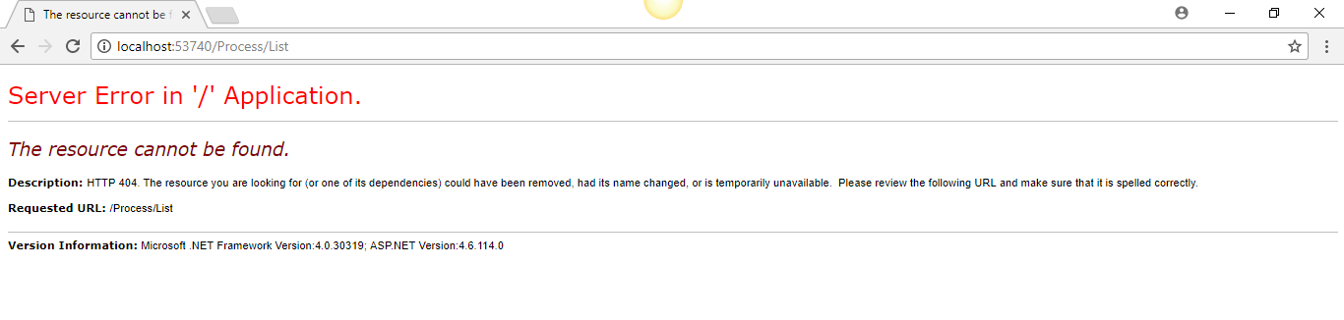

ASP.NET MVC – Custom Route Convention
Consider we have a page that contains the list of processes.
When someone comes in and looks for a URL with Process/List/Id
Add new ProcessController
Add List as an Action method
Add MapRoute method in RouteConfig
Demo

Slide 20
ASP.NET MVC - Controllers
Controllers are essentially the central unit of your ASP.NET MVC application.
It is the 1st recipient, which interacts with incoming HTTP Request
Controllers are C# classes inheriting from System.Web.Mvc.Controller, which is the built in controller base class
Each public method in a controller is known as an action method, meaning you can invoke it from the Web via some URL to perform an action.
The MVC convention is to put controllers in the Controllers folder that Visual Studio created when the project was set up.
Demo

Slide 21
ASP.NET MVC - Actions
It responsible to execute requests and generate responses to it.
By default, it generates a response in the form of ActionResult
Actions typically have a one-to-one mapping with user interactions.
The one restriction on action method is that they have to be instance method, so they cannot be static methods.
there is no return value restrictions. So you can return the string, integer, etc.
Actions are the ultimate request destination in an MVC application and it uses the controller base class

Slide 22
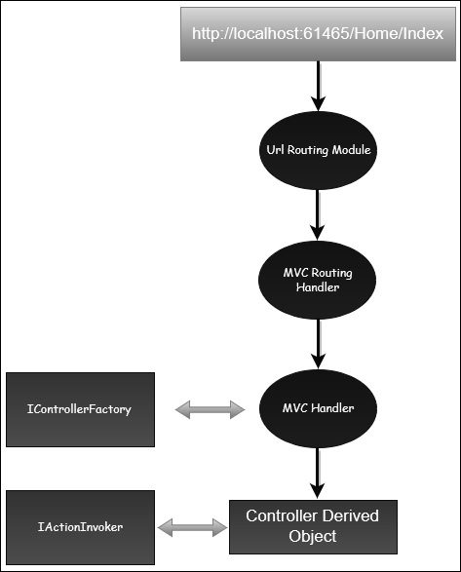
ASP.NET MVC – Actions (Request Processing)
UrlRoutingModule inspects and understands that something configured within the routing table knows how to handle that URL
The UrlRoutingModule puts together the information we've configured in the routing table and hands over control to the MVC route handler
The MVC route handler passes the controller over to the MvcHandler which is an HTTP handler
MvcHandler uses a controller factory to instantiate the controller and it knows what controller to instantiate because it looks in the RouteData for that controller value
Once the MvcHandler has a controller, the only thing that MvcHandler knows about is IController Interface, so it simply tells the controller to execute.
When it tells the controller to execute, that's been derived from the MVC's controller base class. The Execute method creates an action invoker and tells that action invoker to go and find a method to invoke, find an action to invoke.
The action invoker, again, looks in the RouteData and finds that action parameter that's been passed along from the routing engine.

Slide 23
ASP.NET MVC – Types of Action
Actions basically return different types of action results. The ActionResult class is the base for all action results
ContentResult : Returns a string
FileContentResult : Returns file content
FilePathResult : Returns file content
FileStreamResult : Returns file content
EmptyResult : Returns nothing
JavaScriptResult : Returns script for execution
JsonResult : Returns JSON formatted data
RedirectToResult : Redirects to the specified URL
HttpUnauthorizedResult : Returns 403 HTTP Status code
RedirectToRouteResult :Redirects to different action/different controller action
ViewResult : Received as a response for view engine
PartialViewResult: Received as a response for view engine
Demo

Slide 24
ASP.NET MVC - Filters
In ASP.NET MVC, controllers define action methods that usually have a one-to-one relationship with possible user interactions
Sometimes you want to perform logic either before an action method is called or after an action method runs
To support this, ASP.NET MVC provides filters.
Filters are custom classes that provide both a declarative and programmatic means to add pre-action and post-action behavior to controller action methods
Types of Filters
The ASP.NET MVC framework supports four different types of filters. Filters are executed in the order listed below
Authorization Filters − Implements the IAuthorizationFilter attribute.
Action Filters − Implements the IActionFilter attribute.
Result Filters − Implements the IResultFilter attribute.
Exception Filters − Implements the IExceptionFilter attribute.

Slide 25
ASP.NET MVC – Filters (Contd.)
Action Filters
An action filter is an attribute that you can apply to a controller action or an entire controller that modifies the way in which the action is executed. The ASP.NET MVC framework includes several action filters −
OutputCache − Caches the output of a controller action for a specified amount of time.
HandleError − Handles errors raised when a controller action is executed.
Authorize − Enables you to restrict access to a particular user or role.
Custom Filters
ASP.NET MVC framework provides a base class which is known as ActionFilterAttribute
This class implements both IActionFilter and IResultFilter interfaces and both are derived from the Filter class
Demo

Slide 26
ASP.NET MVC - Selectors
Action selectors are attributes that can be applied to action methods and are used to influence which action method gets invoked in response to a request.
It helps the routing engine to select the correct action method to handle a particular request.
These selectors will decide the behavior of the method invocation based on the modified name given in front of the action method
It is usually used to alias the name of the action method.
Types of Selectors
ActionName :
An attribute that is used for the name of an action
Allows us to use a different action name than the method name
NonAction :
It indicates that a public method of a Controller is not an action method.
It is used when you want that a method shouldn’t be treated as an action method.
ActionVerbs :
It restricts the indication of a specific action to specific HttpVerbs.
You can define two different action methods with the same name but one action method responds to an HTTP Get request and another action method responds to an HTTP Post request.

Slide 27
ASP.NET MVC – Selectors (Contd.)
MVC framework supports the following ActionVerbs.
HttpGet
HttpPost
HttpPut
HttpDelete
HttpOptions
HttpPatch
Demo

Slide 28
ASP.NET MVC - Views
In an ASP.NET MVC application, there is nothing like a page and it also doesn’t include anything that directly corresponds to a page when you specify a path in URL. The closest thing to a page in an ASP.NET MVC application is known as a View.
All incoming browser requests are handled by the controller and these requests are mapped to controller actions.
A controller action might return a view or it might also perform some other type of action such as redirecting to another controller action.
Demo

Slide 29
ASP.NET MVC - Data Model
A model stores data that is retrieved according to the commands from the Controller and displayed in the View.
Model is a collection of classes where in you will be working with data and business logic.
Basically models are business domain-specific containers
It is used to interact with database. It can also be used to manipulate the data to implement the business logic.
Demo

Slide 30
ASP.NET MVC - Databases
How to use a database engine in order to store and retrieve the data needed for your application
To store and retrieve data, we will use a .NET Framework data-access technology known as the Entity Framework to define and work with Models.
The Entity Framework (EF) supports Code First technique, which allows you to create model objects by writing simple classes and then the database will be created on the fly from your classes, which enables a very clean and rapid development workflow
Demo

Slide 31
ASP.NET MVC - Validation
ASP.NET MVC provides a set of validation that is easy-to-use and at the same time, it is also a powerful way to check for errors and, if necessary, display messages to the user
DataAnnotations is used to configure your model classes, which will highlight the most commonly needed configurations
Adding data annotations to our model class which provides some built in set of validation attributes that can be applied to any model class or property directly in your application, such as Required, StringLength, RegularExpression, and Range validation attributes
The validation attributes specify behavior that you want to enforce on the model properties they are applied to.
The Required and MinimumLength attributes indicates that a property must have a value, but nothing prevents a user from entering white space to satisfy this validation.
The RegularExpression attribute is used to limit what characters can be input.
Demo

Slide 32
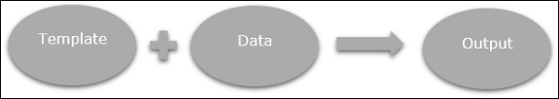
ASP.NET MVC - Razor
Razor is a markup syntax that lets you embed server-based code into web pages using C# and VB.Net
It is not a programming language. It is a server side markup language.
ASP.NET MVC has implemented a view engine that allows us to use Razor inside of an MVC application to produce HTML.
Goals
Microsoft wanted Razor to be easy to use and easy to learn, and work inside of tools like Visual Studio so that IntelliSense is available, the debugger is available, but they wanted Razor to have no ties to a specific technology, like ASP.NET or ASP.NET MVC.
There's a dependency on the ASP.NET runtime to be available to parse and execute those ASPX files. Microsoft wanted Razor to be smart, to make a developer's job easier.

Slide 33
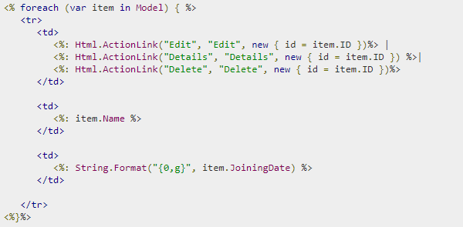
ASP.NET MVC – Razor (Contd.)
Let’s take a look at a sample code from an ASPX file, which contains some literal text. This is our HTML markup. It also contains little bits of C# code.
The syntax is a bit clunky when you need to transition from C# code back to HTML and from HTML code back into C# code
You are also prompted by IntelliSense to do things that just don't make sense in an MVC project, like add directives for output caching and user controls into an ASPX view

Slide 34
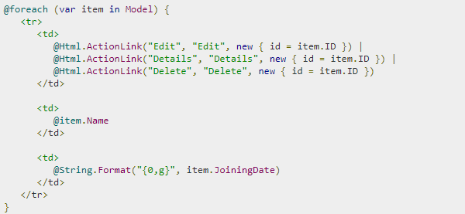
ASP.NET MVC – Razor (Contd.)
Now look at this code which produces the same output, the difference being it is using the Razor syntax
With Razor syntax you can begin a bit of C# code by using the ‘@’ sign and the Razor parse will automatically switch into parsing this statement, as a bit of C# code.
The Razor parser is smart enough to switch between C# code and HTML and again, from HTML back into C# code when we need to place our closing curly brace here
Demo

